Slide 1

Aurora-Gov: Gratis full PM tool for government employees
&
Aurora-Viewer free P6 viewer for all
June 24, 2026
National Shipbuilding Research Program (NSRP)
Business Technologies (BT) Joint Panel Meeting
Baltimore Maryland
June 23 - 25, 2026
  Distribution. Approved for Public Release: Distribution Unlimited

Slide 2
Aurora-Gov Summary
World’s most intelligent scheduling engine with real-world modeling capabilities
  Model more real-world details
  Multiple-pass intelligent resource-constrained scheduling
    Shorter real-world projects / faster throughput

Slide 3
Aurora Capabilities Beyond P6
Project Planning/ Modeling
Concurrent constraints
Non-Concurrent constraints
Absolute FInish-to-Constraint: successor task starts immediately
Advanced offset (lead and lag) to account for actual progress on related task, not just a fixed time
Maximum lag constraint, which initiates a countdown or expiration period when one task starts, setting a time limit for the commencement of a related task.
Preferred Resources – This allows the user to specify a preference order when defining a set of resources that are mostly interchangeable. E.g., Prefer work in default shop Prefer work by tech, but supervisor can substitute Prefer certain equipment Prefer certain lab space Use consistent auditors for a client
More powerful variable duration activities – This allows the user to specify that a job could use more people and get done more quickly, or fewer people and get done more slowly, as well as other efficiency options.
Shift based constraint: Task needs to be completed during single shift
Shift based constraint: Do not start task unless x% of time left in shift
Shift based constraint: Only start a task if it can finish during the same shift
Shift based constraint: Task can only be performed during a specific shift
Shift based constraint: Task can take multiple shifts, but requires the same resources (e.g., specific people)
Ergonomic Constraints – Consider human physical limitations. For example, workers may have limitations on how long they can work on their knees, both in one sitting and throughout the whole shift.
Spatial / physical space constraints: Task requires a certain location or type of space Including the creation and elimination of the space during the project
Alternative Resource Combinations Plumber & Mechanic a task may require a Plumber and a Mechanic; however, there may also be Cross-trained person that can perform Plumber and Mechanic operations. So, the resource requirements for a task could be (Plumb & Mech) OR (Cross-trained). For cases where the same number of people are always needed, the resource requirement could be ((Plumb & Mech) OR (Cross-trained & Mech) OR (Plumb & Cross-trained) OR (2 Cross-trained)). Aurora’s intelligent scheduling assigns the Cross-trained individuals to maximize throughput
Hierarchy of Labor Resource Occupations and skills/certifications
Cross-shift resource coordination Coordinates resources and activities across multiple shifts while preserving continuity and operational rules
Support tasks that can be outsourced if deadlines can not be met
Capacity Change Constraints – This allows the user to specify a relationship between a task and a resource. Some tasks may make a resource available (e.g., adding a space zone that can subsequently be used for work), others may make a resource unavailable (e.g., installing panels that block access to a space zone).
Jig/Fixture Support – This is specialized support that ensures that a jig or fixture is assigned to a series of work and will be retained throughout the work statement.
Calendar support for all tasks and resources Work on task only when task calendar and ALL resource calendars overlap, as well as any other type of constraints are satisfied e.g., shift based constraints
Task Durations: More options to define safe and aggressive durations.
Constraint definitions: Includes the ability to include more information about constraints (such as justifications and additional notes), as well as the option to make the constraint active or not.
Scheduling & Resource Management
Optimize resource utilization beyond resource leveling. Resulting in greater throughput not only in the planning phase, but more importantly during the execution phase
Chokepoint-aware scheduling Pre-analyzes constrained resources and prioritizes critical resource chokepoints before scheduling
Intelligent execution updates Automatically updates schedules using execution data
Schedule Explanation for each task, why it was scheduled where it was scheduled
As soon as possible scheduling (ASAP)
As late as possible scheduling (ALAP)
Mixed-mode scheduling, some tasks are ASAP & others are ALAP
More flexible task calendars: Define working hours, non-working days, and exceptions for individual tasks or resources.
More flexible resource calendars: Specify working hours, holidays, and other non-working times for project resources.
Risk Analysis / Monte Carlo analysis
Monte Carlos risk analysis (ignoring resources)
Monte Carlos risk analysis (considering resource limitations)
Sensitivity analysis Evaluates how changes in key task durations affect the overall schedule
Graphical, Reporting & General
Single-element View: Pick a task and view relationships to nearest neighbors & walk through related tasks
Upstream/downstream task analysis Analyzes dependency chains both upstream and downstream from selected tasks (including resource dependencies)
Tabular representation of all data available with smart cut/paste with Excel and other spreadsheets
More extensive accumulation & burndown plots
More extensive criteria-based appearance control & filtering
More extensive criteria-based appearance filtering
Monte Carlo / risk analysis
Relationship Diagramming Method (RDM) capabilities
Relationship Diagramming Critical Path Method (RDCPM) capabilities
Point-to-point network analysis Finds and analyzes dependency paths between two selected tasks or milestones (including resource dependencies)
More powerful interactive scenario analysis, Rich visualization and scenario experimentation
More powerful visual display of constraint interactions and schedule logic including resource dependencies
Run logic checks: Including DCMA Reports & unique Aurora analyses
Support for Huge models
Integration and Compatibility
Built for third-party integration: Integrate with third-party tools and services through APIs or connectors to extend functionality and support specific project requirements.

Slide 4
Aurora-Viewer
Free P6 viewer for all
https://www.aurorascheduling.com/aurora-viewer/

Slide 5

Aurora-Viewer
Free standalone Windows application for opening and analyzing Primavera P6 .XER schedule files without requiring a Primavera license.
Provides fast access to schedule data, logic tracing, and schedule review for users who do not need full Primavera editing capabilities.
Evolving: welcome input / feedback

Slide 6
Views
Project Overview Report
  Includes activity details, calendars, job-type analysis, and schedule quality indicators.
Gantt Charts
Tabular/Spreadsheet View
Single-Element View
Analysis

Slide 7
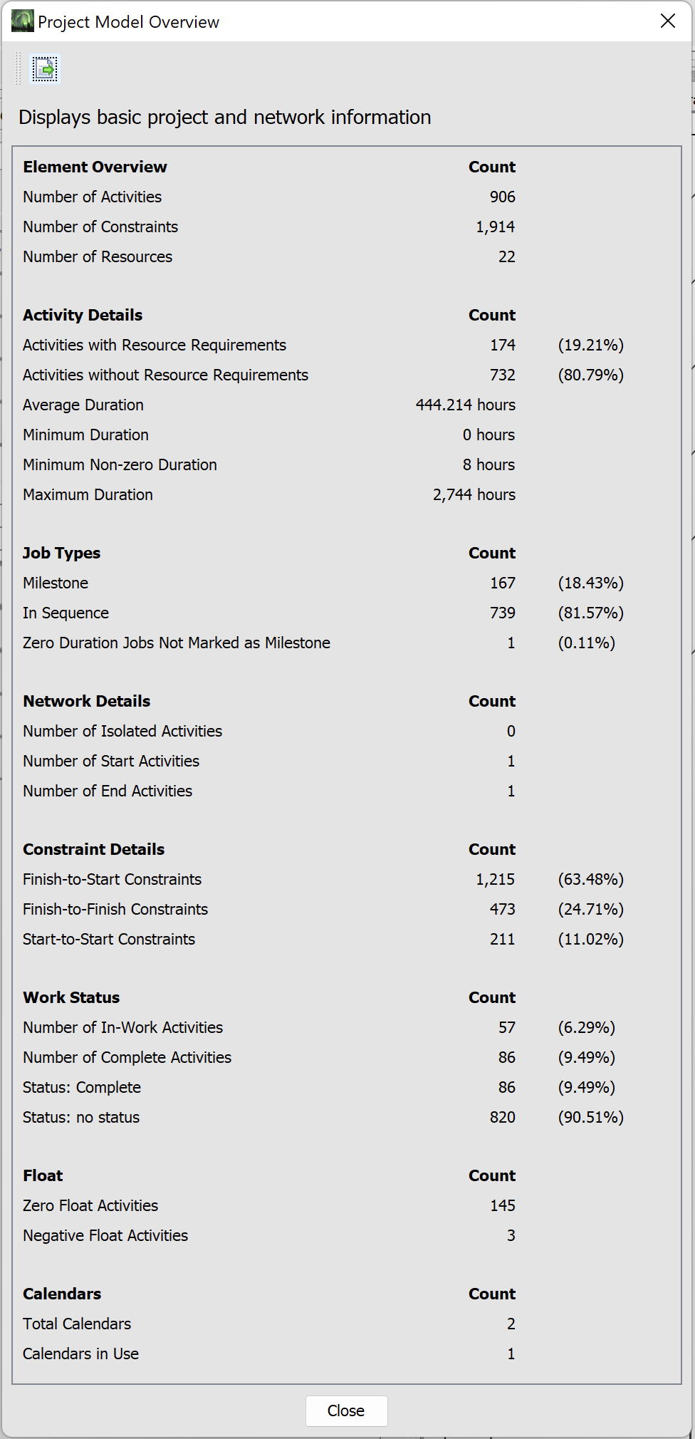
Project Model Overview

Slide 8
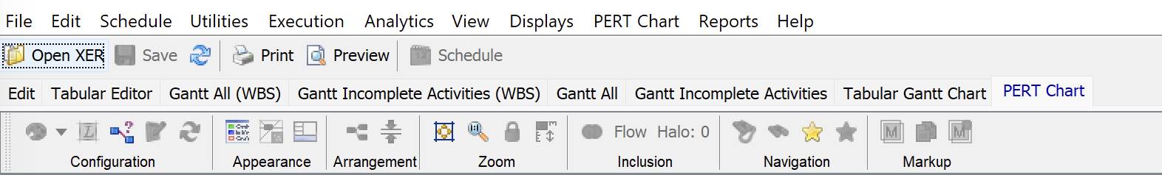
Tabbed Interface

Slide 9
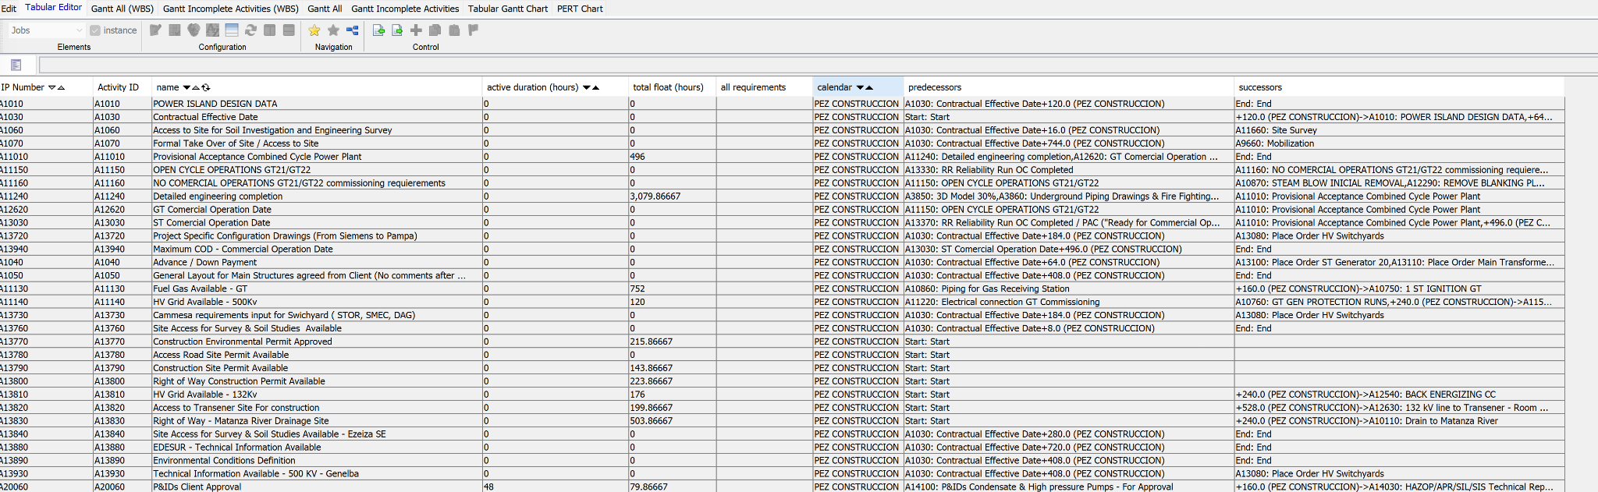
Tabular Editor

Slide 10
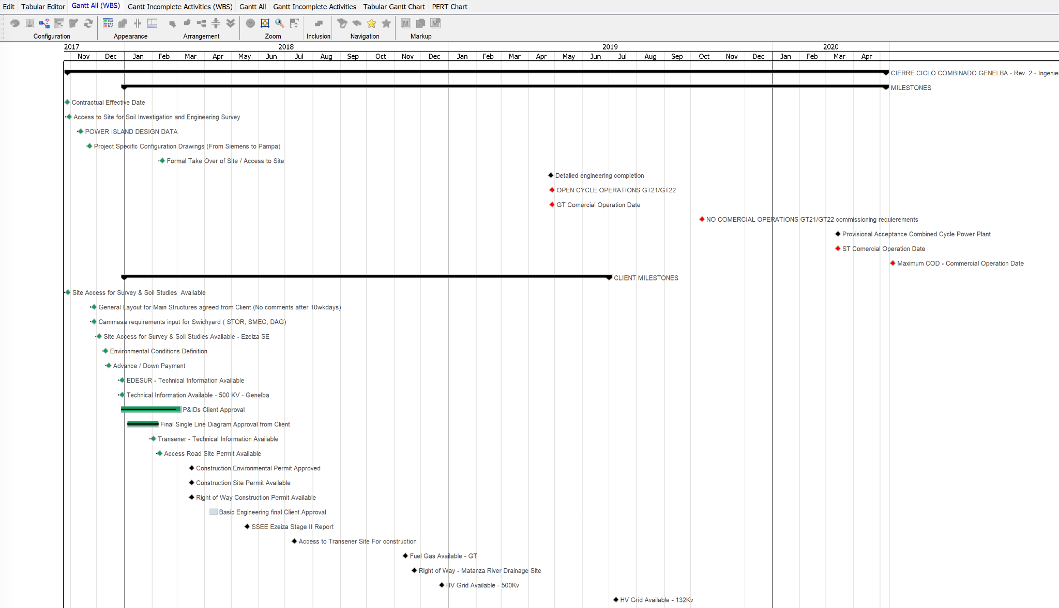
Gantt All (WBS)

Slide 11
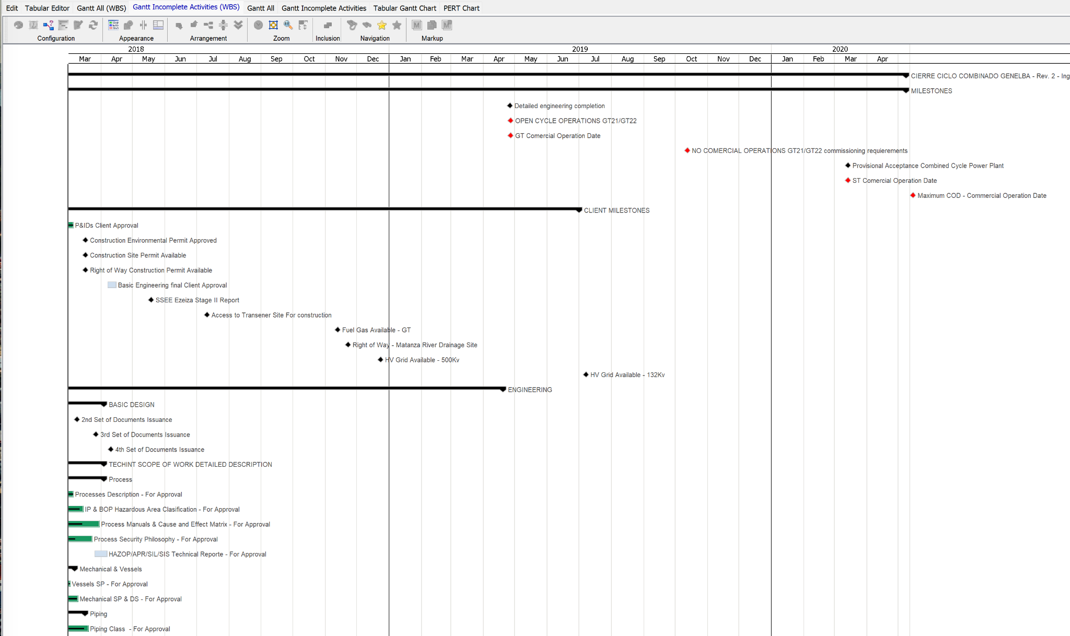
Gantt Incomplete Activities (WBS)

Slide 12
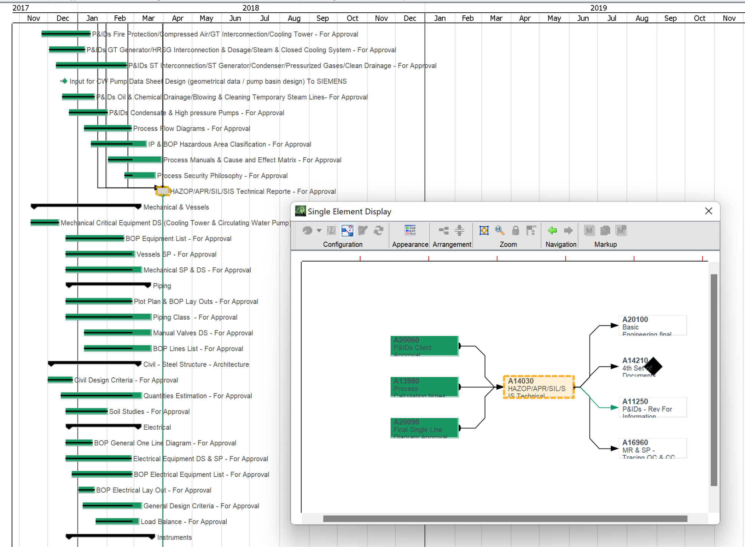
Single Element View

Slide 13
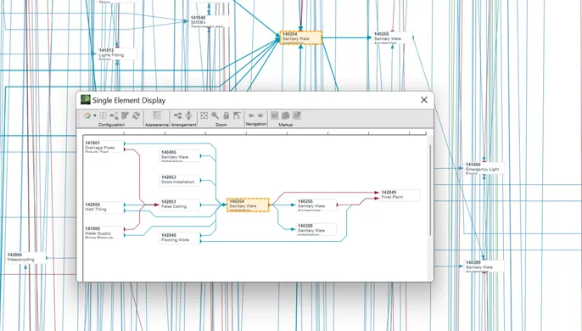
Single Element View

Slide 14
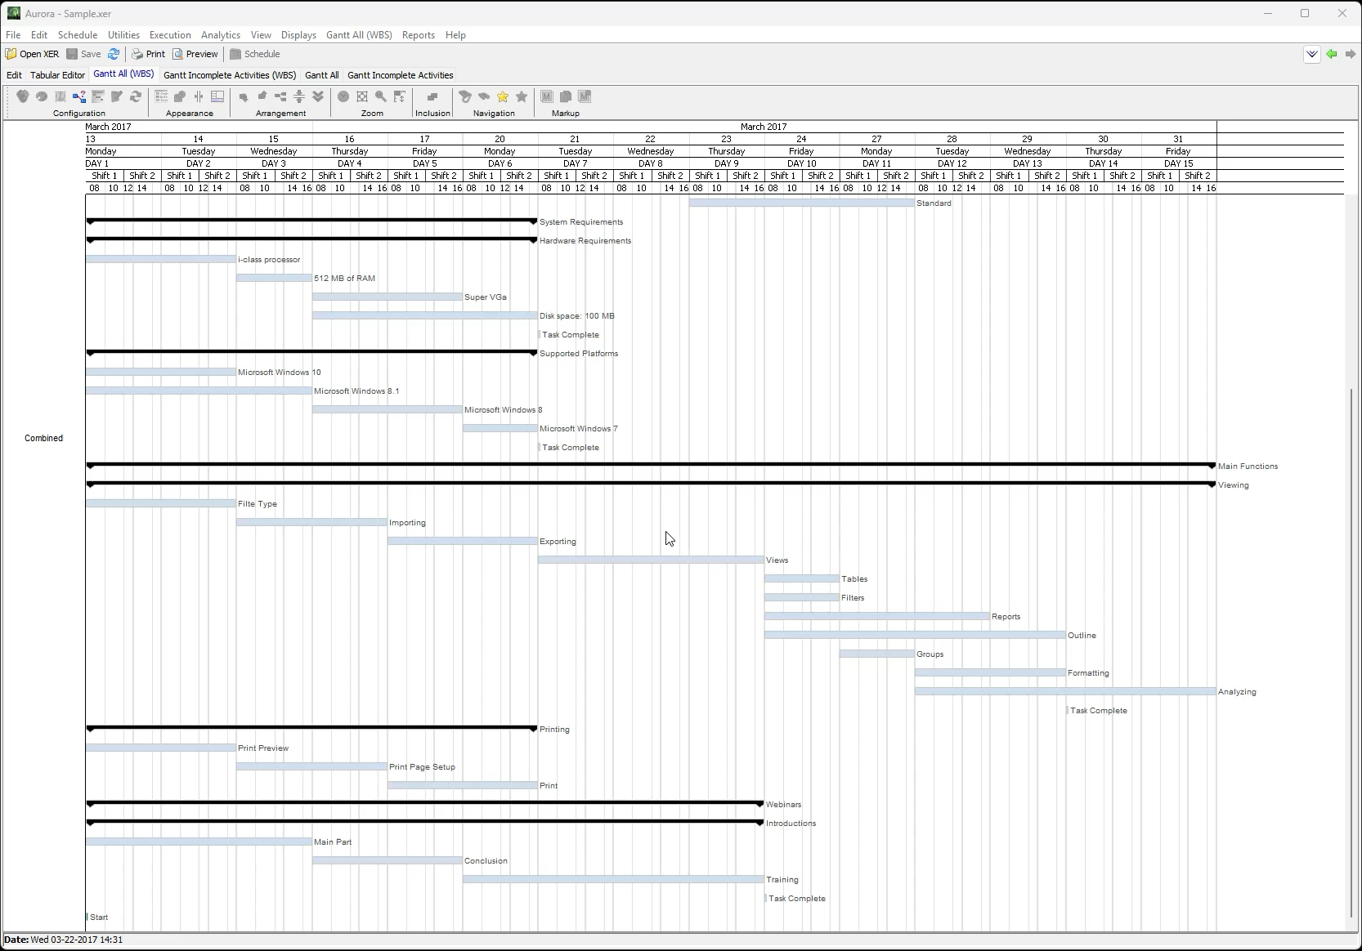
Single Element Display Video

Slide 15
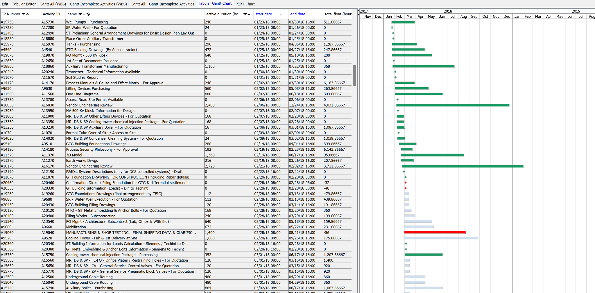
Tabular Gantt

Slide 16
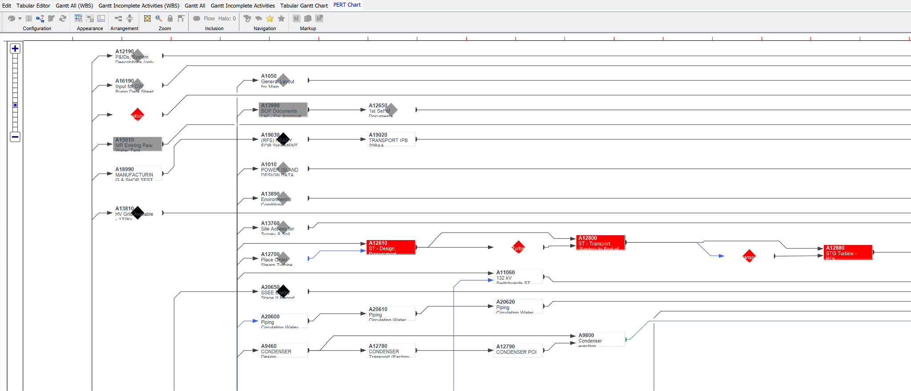
Network PERT Diagram

Slide 17
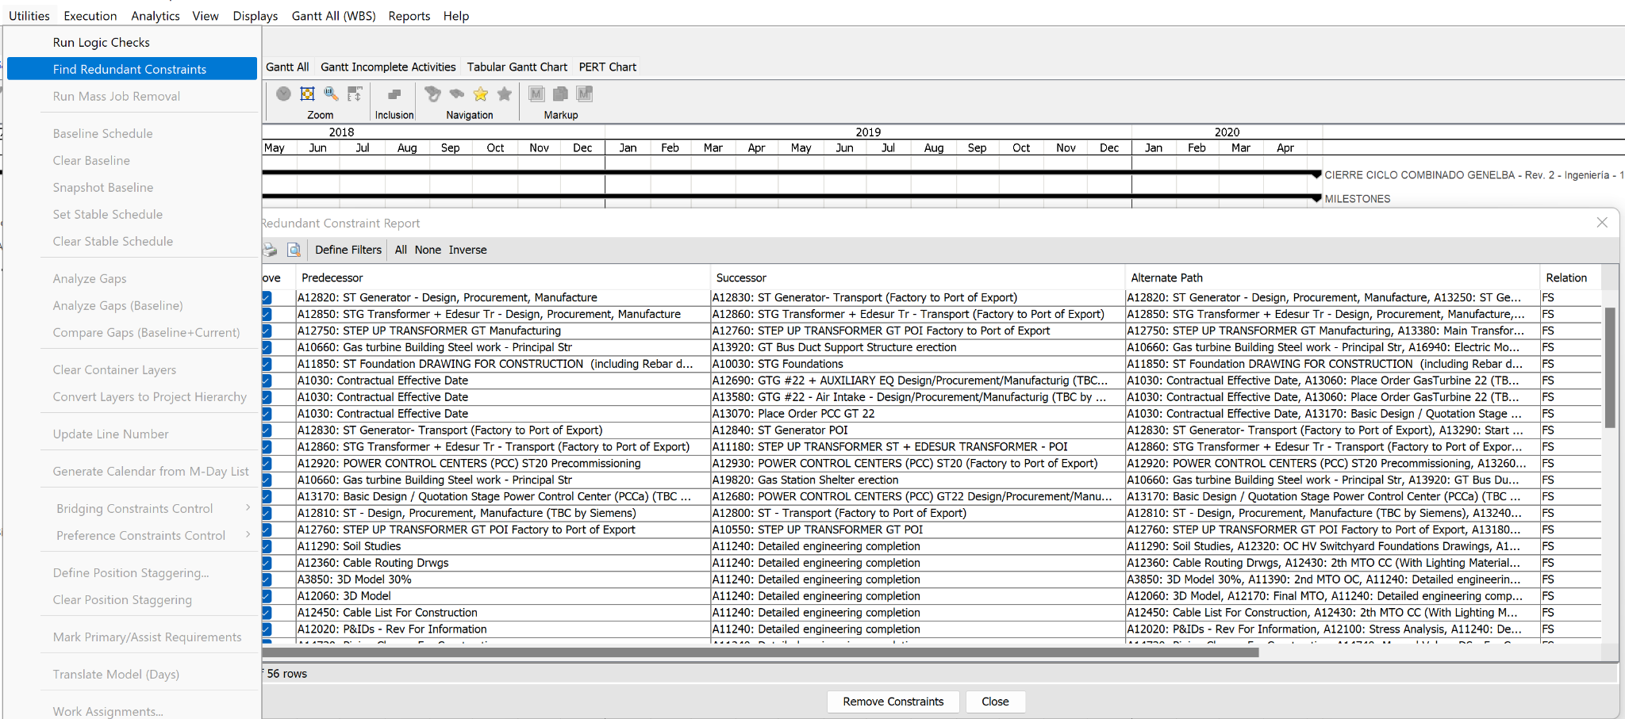
Utilities
(E.g., Find Redundant Constraints)

Slide 18
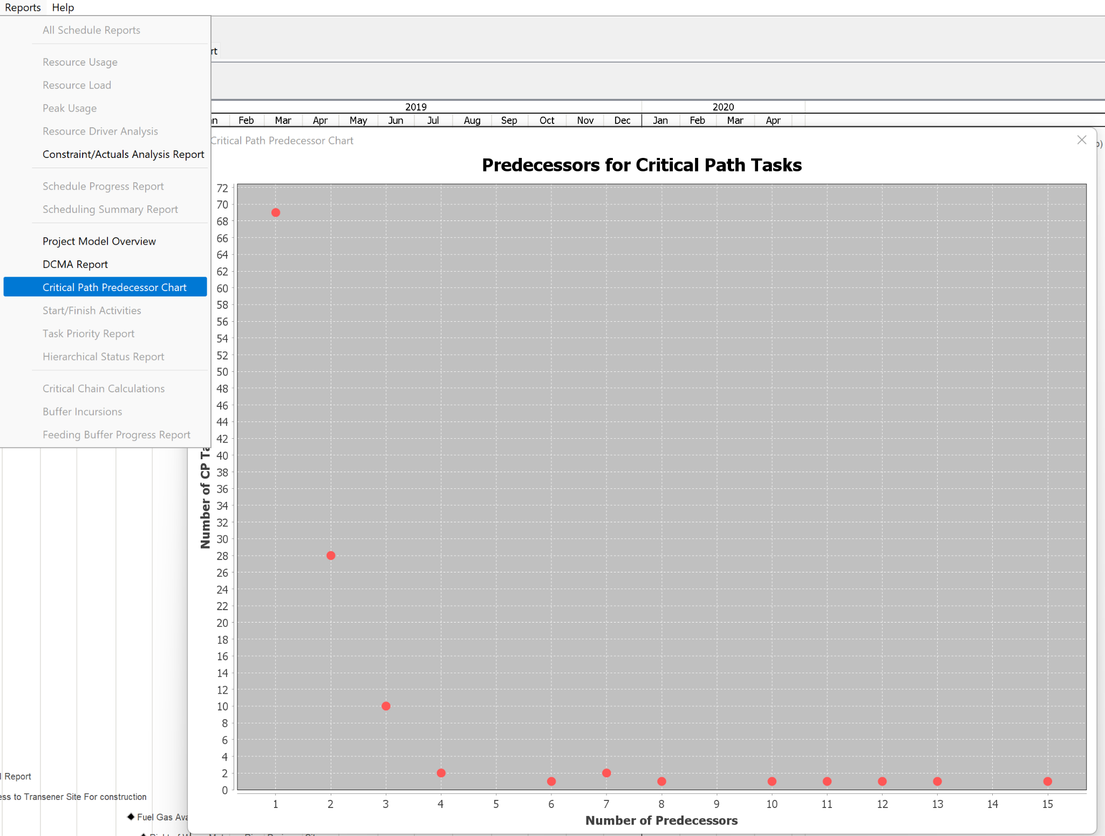
Reports
E.g., Predecessors for CP Tasks

Slide 19
Aurora-Gov:
Enhancements to Traditional Project Management
Traditional Project Management
Intelligent Scheduling
Model Detail
www.StottlerHenke.com
Notes:
Today I will discuss a methodology and tool that allows for the significant benefits of Intelligent Scheduling &/or Critical Chain to be applied with minimal change to current workflow.

Slide 20
Benefits of Aurora-Gov
Current Benefits
Greater throughput with same resources
Realistic Execution Updates
Notes:
Today I will discuss a methodology and tool that allows for the significant benefits of Intelligent Scheduling &/or Critical Chain to be applied with minimal change to current workflow.

Slide 21
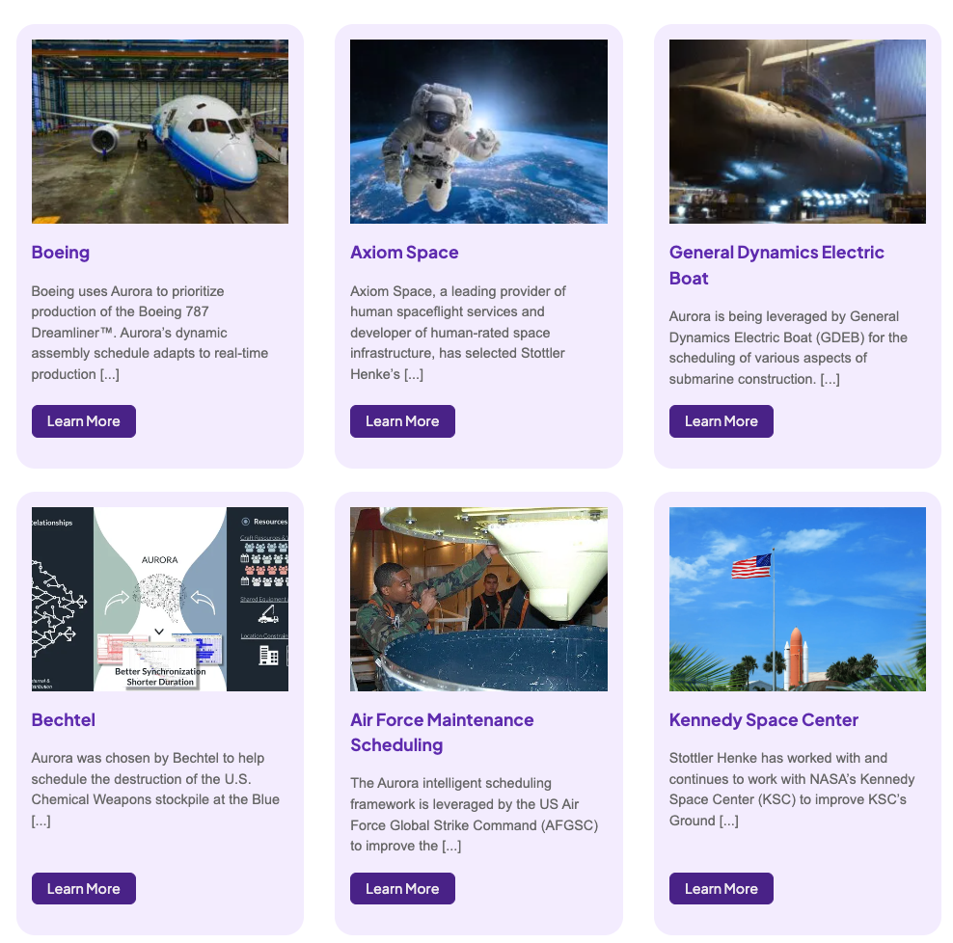
Aurora Customers (1)

Slide 22
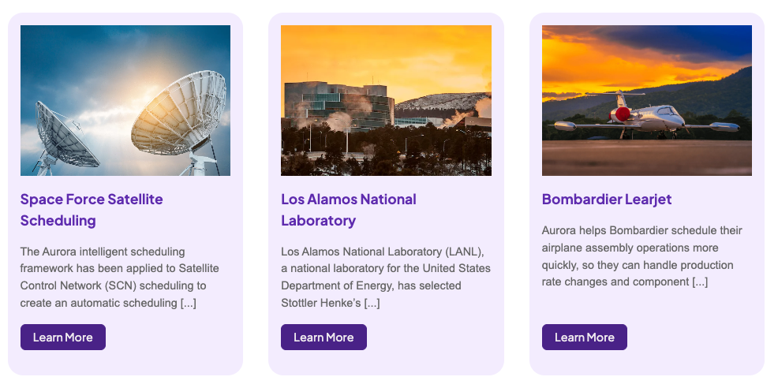

Aurora Customers (2)

Slide 23
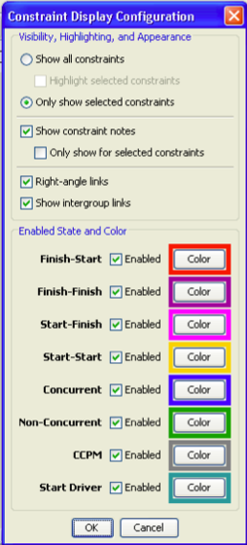
Constraints Add Complexity
Technical constraints (E.g., F-S, F-F, S-F, lags)
Resource constraints
  Labor constraints
  Equipment, Tools (e.g., cranes)
Usage constraints – e.g., tool can only be used for so many hours continuously &/or during a day.
Spatial / physical space constraints – e.g.,
  job requires a certain location or type of space;
  two elements should (or should not) be next to each other
Ergonomic constraints – individual limitations on work conditions

Slide 24
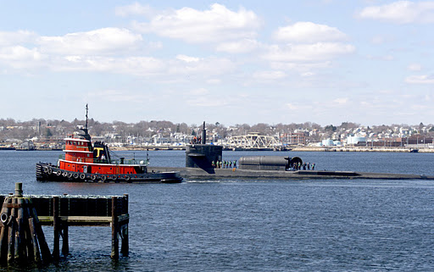
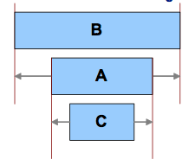
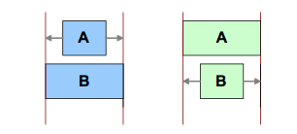
Concurrent & Non-Concurrent
Complex operations requires concept of concurrent & non-concurrent tasks
Adds another layer of complexity

Slide 25
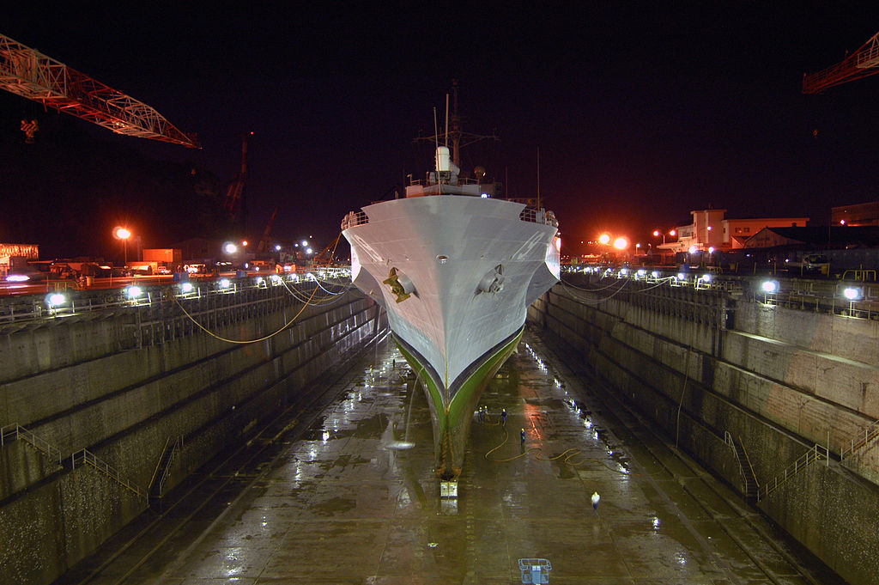
More Complexity:
Shipbuilding & Ship Maintenance
Ingress & egress: limited
Skills / Certifications in addition to Occupations
  E.g., Mechanic (occupation) with 4 additional skills or certifications
Constraints based on status/state
  E.g., no hot work when other conditions in effect
Shift based constraints
  Task needs to be completed during single shift
  Do not start task unless x% of time left in shift

Slide 26
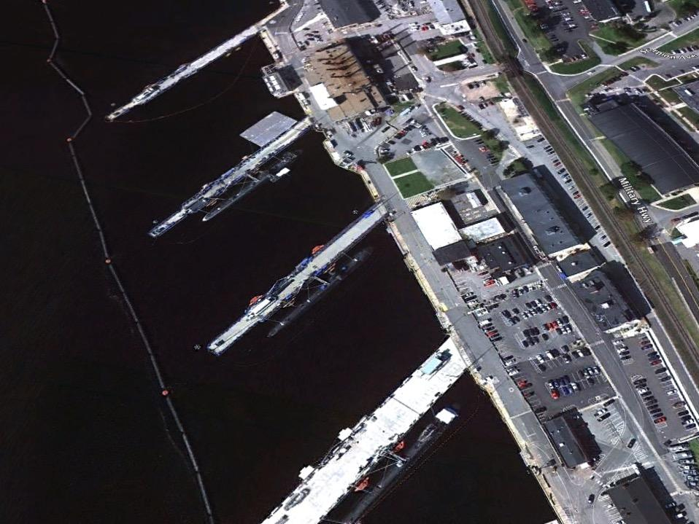
NSSF: Submarine Maintenance
Each dock is different
Different work rules if another submarine on other side of pier
Each crane is different & there is a waterborne crane
Multiple occupations with skills/certifications
  Task may require occupations with skills/certs
    Skill/certs combination needed per task may be by worker or by task

Slide 27

SSI’s ShipConstructor to Aurora

Slide 28
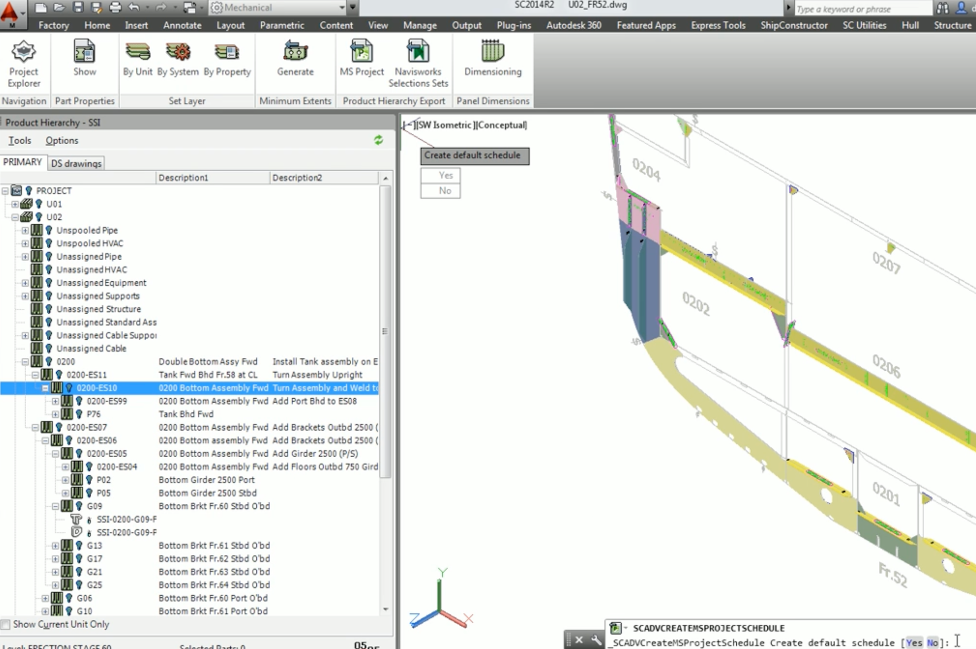
Export to MS Project

Slide 29
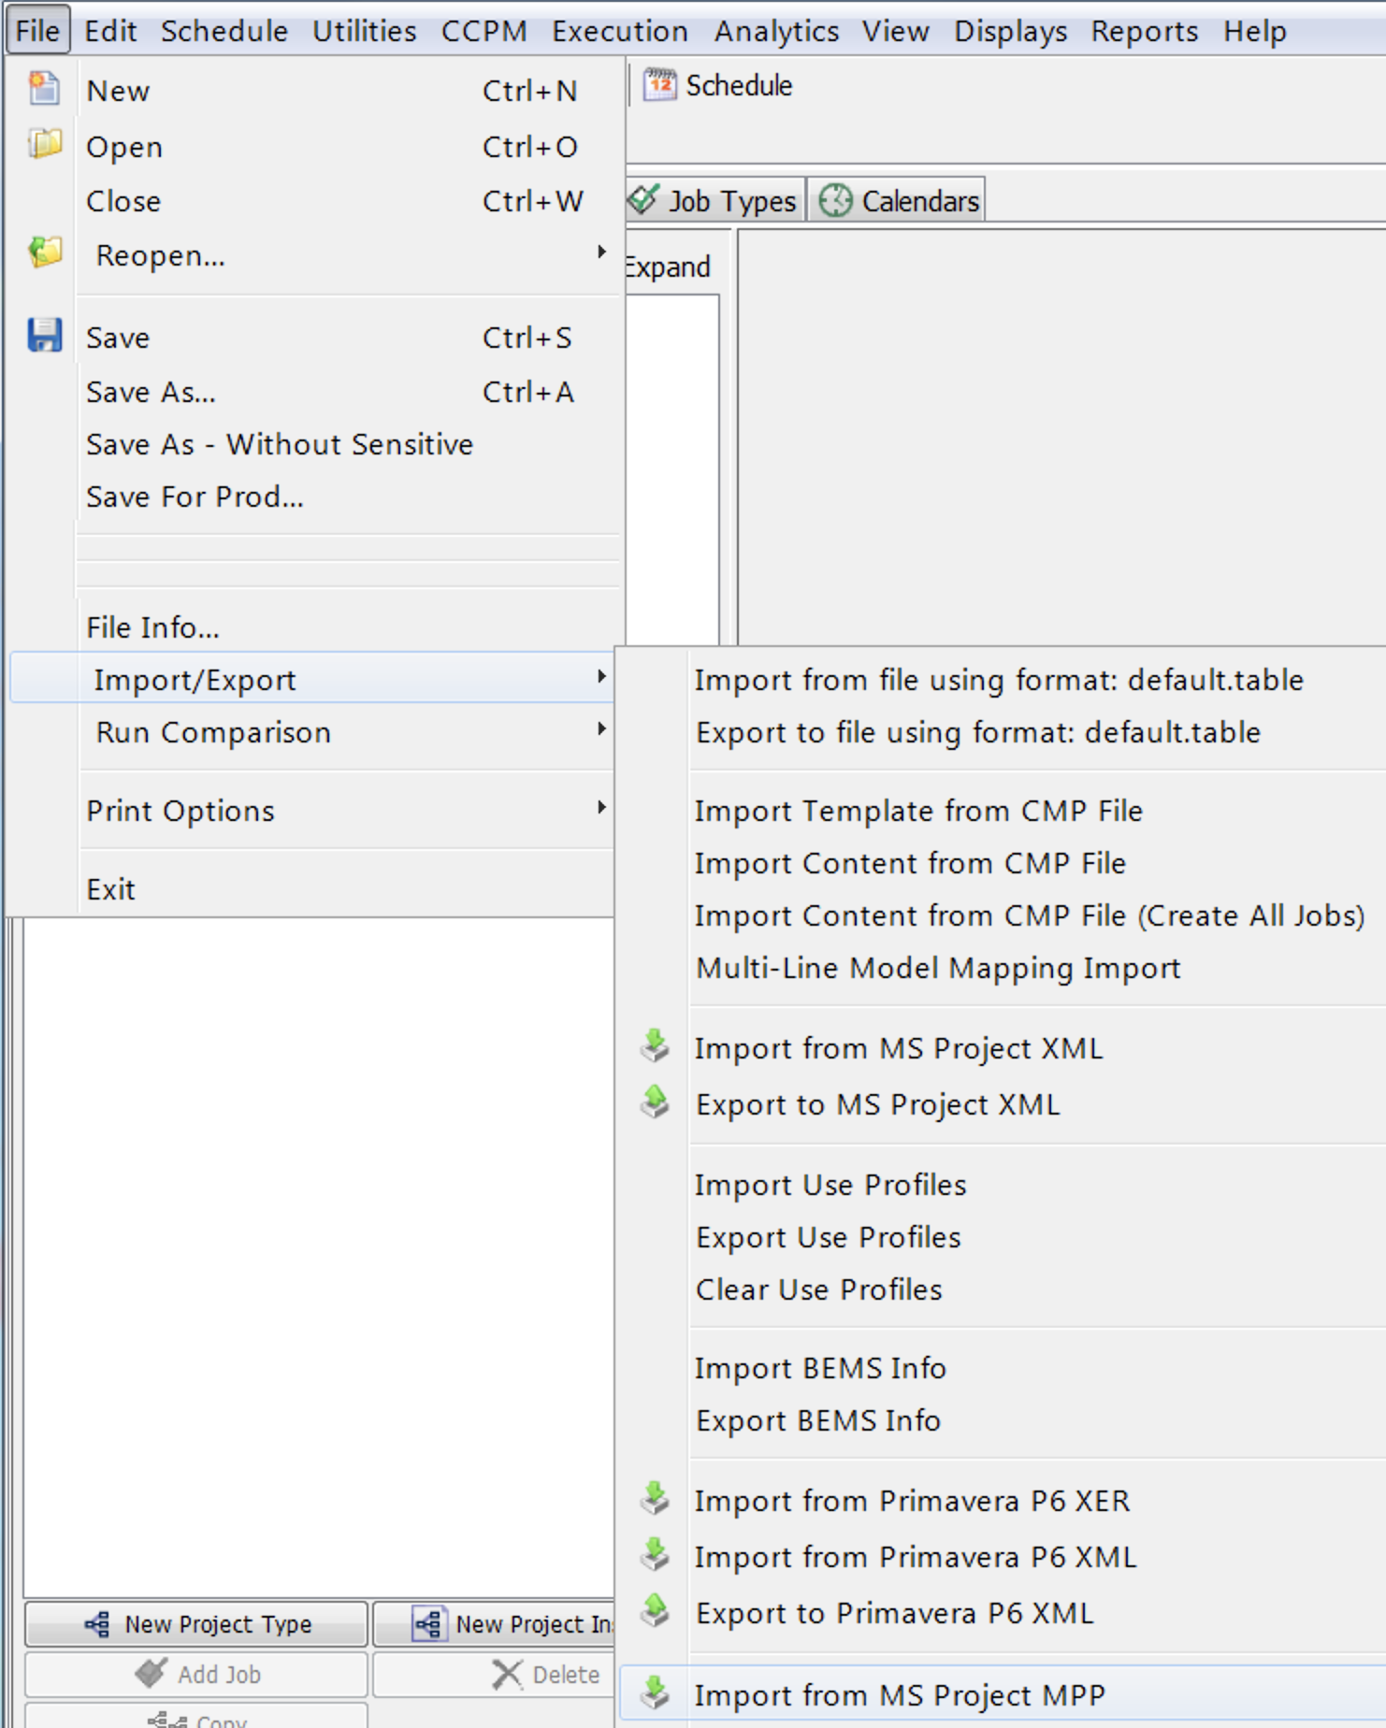
Import into Aurora

Slide 30
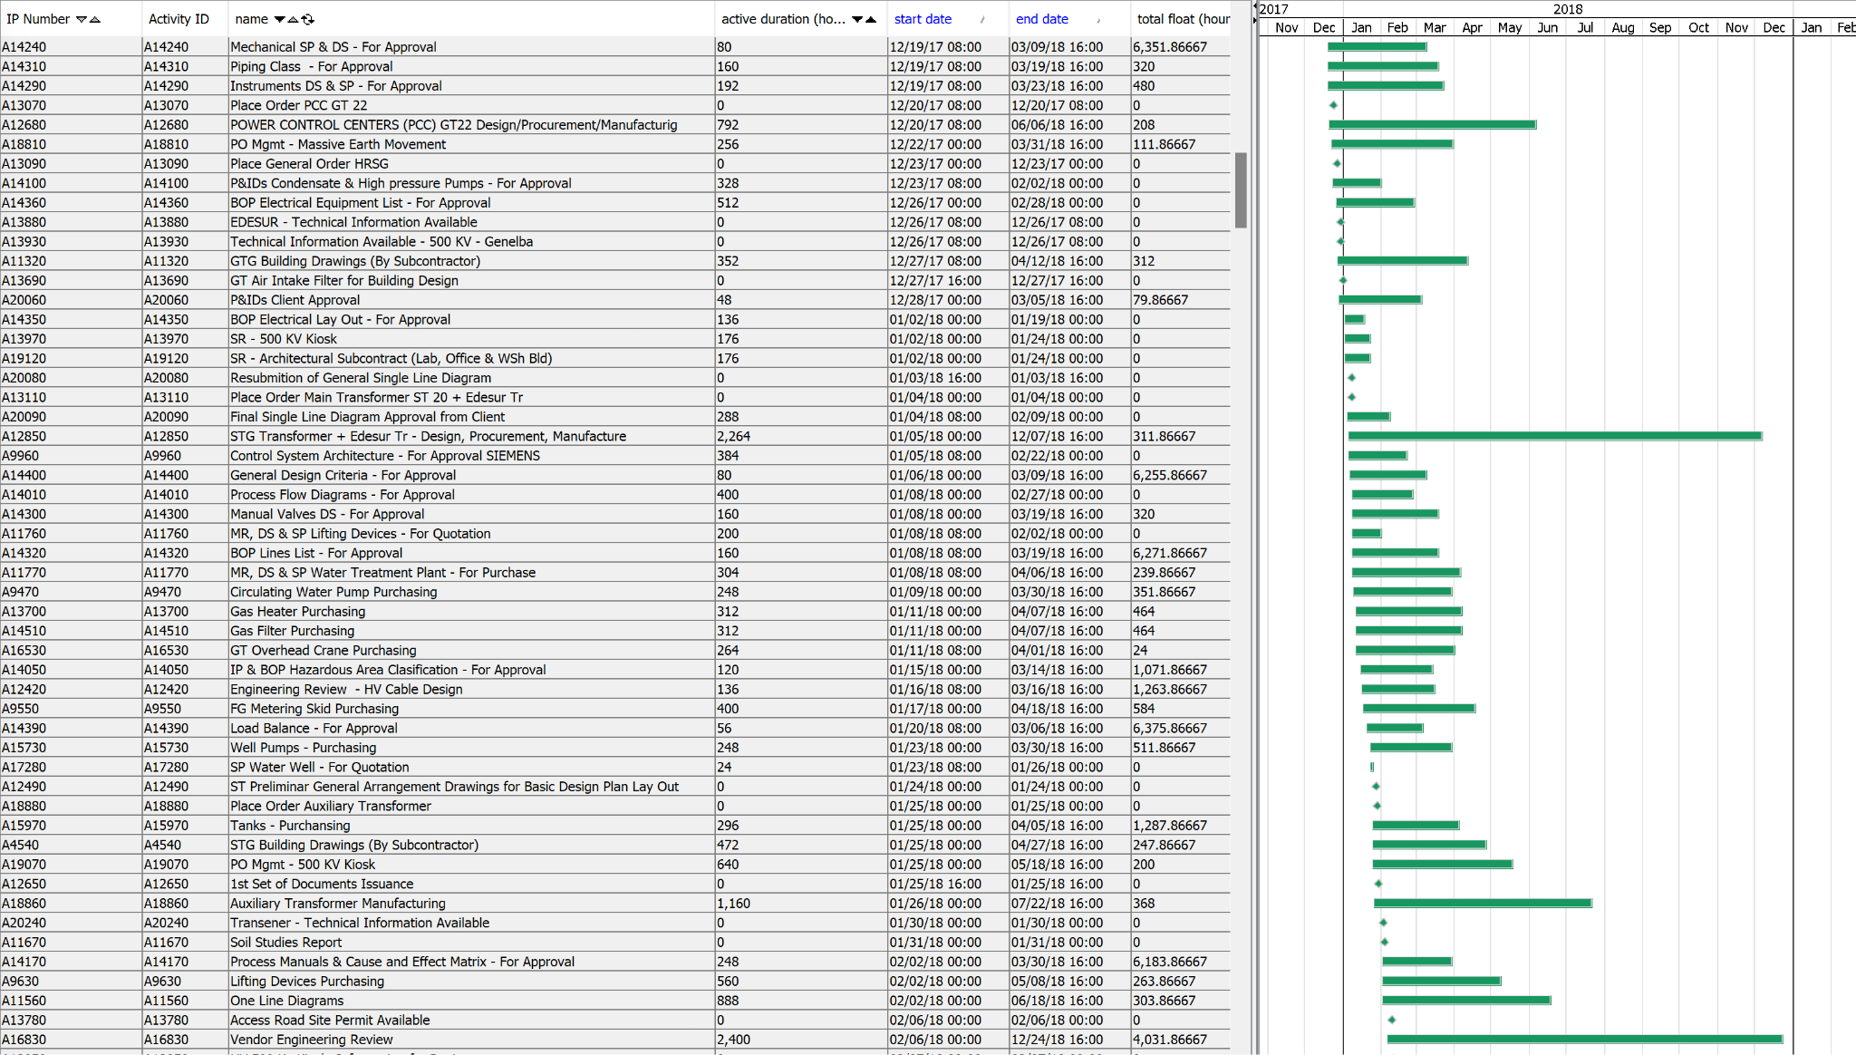
Work with in Aurora

Slide 31
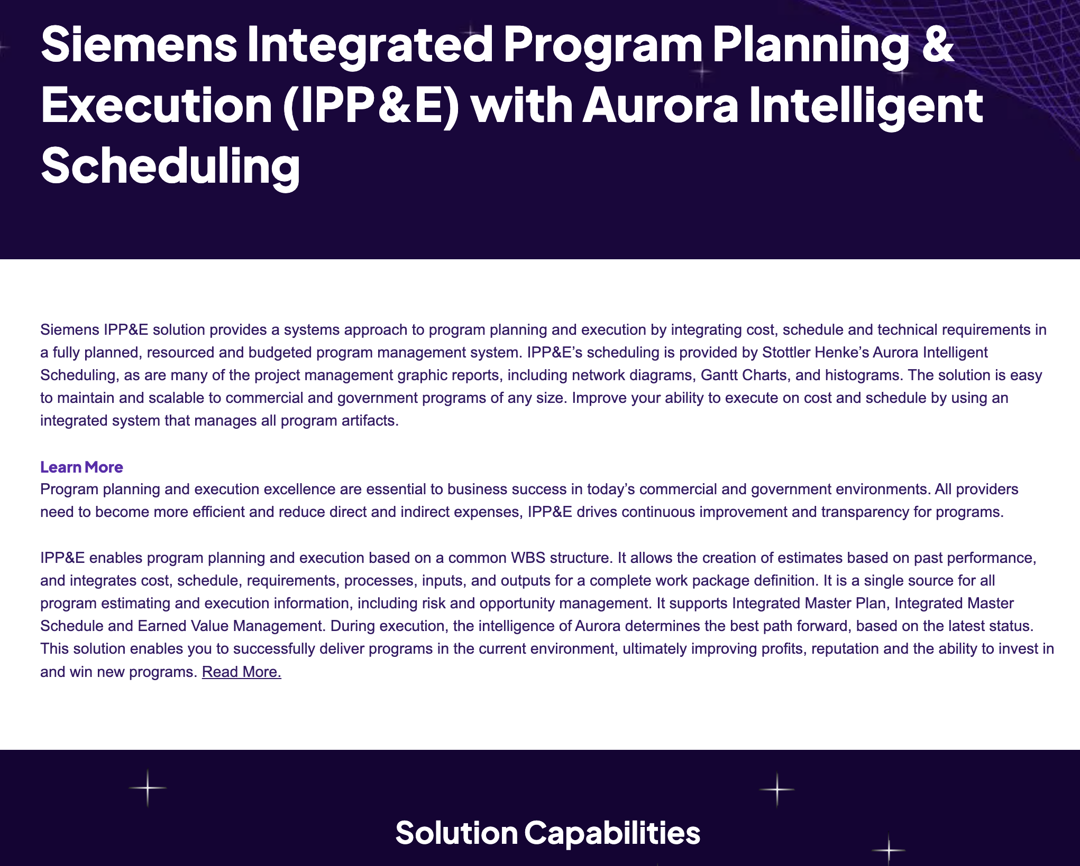
Aurora is the Scheduling Engine in Siemens Xcelerator IPP&E

Slide 32
Aurora-Gov: Gratis full PM tool for government employees
&
Aurora-Viewer free P6 viewer for all
\
National Shipbuilding Research Program (NSRP)
Business Technologies (BT) Joint Panel Meeting
Baltimore Maryland
June 23 - 25, 2026

